Slide 1
Inheritance

Slide 2
Inheritance: Introduction
Reusability--building new components by utilizing existing components- is yet another important aspect of OO paradigm.
It is always good/ “productive” if we are able to reuse something that is already exists rather than creating the same all over again.
This is achieved by creating new classes, reusing the properties of existing classes.
It saves money , time etc.
To use a class that is already created and tested properly saves the effort of testing and developing same again.
In C++ one class is tested and adapted properly can be used by the programmers to suit there requirements.

Slide 3
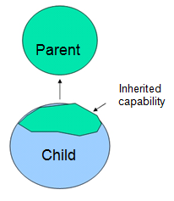
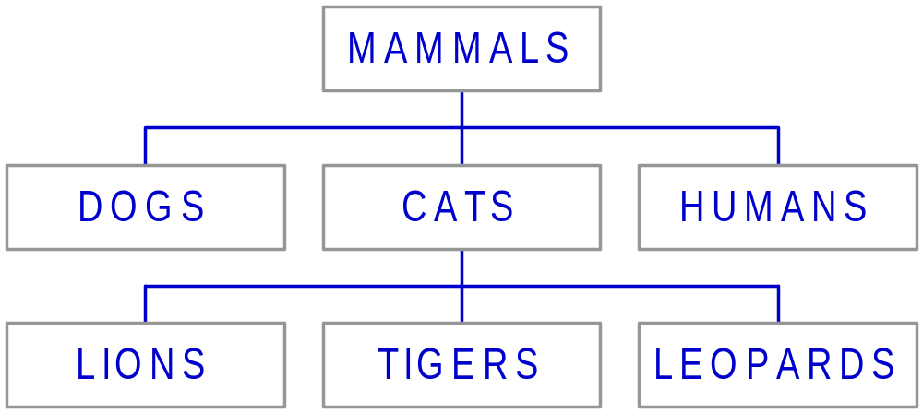
Definition
This mechanism of deriving a new class from existing/old class is called “inheritance”.
The old class is known as “base” class, “super” class or “parent” class”
The new class is known as “sub” class “derived” class, or “child”
class.
Example:

Slide 4
Define a Class Hierarchy
Syntax:
class DerivedClassName : access-level BaseClassName
where
  access-level specifies the type of derivation
    private by default, or
    Public
    Protected
Any class can serve as a base class
  Thus a derived class can also be a base class

Slide 5
Implementing Inheritance in C++ by Deriving Classes From the Base Class
Syntax:
class <base_class>
{
…
};
class <derived_class> : <access-specifier>
<base_class>
{
...
};

Slide 6
What to inherit?
In principle, every member of a base class is inherited by a derived class
  just with different access permission
However, there are exceptions for
  constructor and destructor
  operator=() member
  friends
Since all these functions are class-specific

Slide 7
Access specifiers of derivation
  The public access specifier
  The protected access specifier
  The private access specifier

Slide 8
Access Rights of Derived Classes
Type of Inheritance
 | private | protected | public
private | private | private | private
protected | private | protected | protected
public | private | protected | public
Access Control
for Members
The type of inheritance defines the access level for the members of derived class that are inherited from the base class

Slide 9
Inheritance Relationship (Contd.)
The types of inheritance are:
Single inheritance
Is displayed when a class inherits attributes from a single class
Multilevel inheritance
A
B
A
B
C

Slide 10
Hierarchical inheritance
Hybrid inheritance
Multiple inheritance
A
B
C
D
A
B
C

Slide 11
Class base_class
{
Private:
Int num1;
Public:
Void base_read()
{
Cout<<enter a no”;
Cin>>num1;
}
Void base_show()
{
Cout<<“number is”<<num1;
}
} ;
Class derived_class:public base_class
{
Private:
Int num2;
Public:
Void derived_read()
{
Cout<<“enter no”;
Cin>>num2;
}
Void derived_show()
{
Cout<<“no is”<<num2;
}
};

Slide 12
void main()
{
derived_class d1;
d1.base_read();
d1.derived_read();
d1.base_show();
d1.derived_show();
getch();
}

Slide 13
class base
{
private:
int priv_base;
protected:
int prot_base;
public:
int get_base_priv()
{ priv_base=10;
return(priv_base);
}
};
class derive:public base
{
private:
int priv_der;
protected:
int prot_der;
public:
void f1()
{
int x;
//x=priv_base
x=get_base_priv();
cout<<“value of base private data member”=<<x;
prot_base=20;
cout<< <<“value of base protected data member”=<<prot_base;
}
};

Slide 14
int main()
{
derive d;
int y;
d.f1();
y=d.get_base_priv();
cout<<“value of base private data accessed indirectly=“<<y;
//y=d.prot_base;
return 0;
getch();
}

Slide 15
Multiple Inheritance
Is the phenomenon where a class may inherit from two or more classes
Syntax:
class derived : public base1, public base2
{
//Body of class
};

Slide 16
class base1
{
protected:
int a;
public:
void show().
{
cout<<“value is”<<a;
}
};
class base2
{
protected:
int b;
public:
void display()
{
cout<<“value is”<<b;
}
};

Slide 17
class derived: public base1,public base2
{
public:
void setdata(int x, int y)
{
a=x;
b=y
}
};
void main()
{
derived d;
d.setdata(10,20);
d.show();
d.dispaly();
getch();
}

Slide 18
Ambiguities in Multiple Inheritance
  Can arise when two base classes contain a function of the same name
  Can arise when the derived class has multiple copies of the same base class
Class A
Class B
Class C
Class D

Slide 19
Ambiguities in Multiple Inheritance (Contd.)
Can arise when two base classes contain a function of the same name
Example:
#include<iostream>
  class base1
  {
  public:
  void disp()
  {
  cout << "Base1" <<endl;
  }};

Slide 20
Ambiguities in Multiple Inheritance (Contd.)
  class base2
  {
  public:
  void disp()
  {
  cout << "Base2"<<endl;
  }
  };
  class derived : public base1,public base2
  {
  //Empty class};

Slide 21
Ambiguities in Multiple Inheritance (Contd.)
  int main()
  {
  derived Dvar;
  Dvar.disp(); //Ambiguous function call
  return 0;
}

Slide 22
Ambiguities in Multiple Inheritance (Contd.)
Can be resolved in two ways:
  By using the scope resolution operator
    D1.base1::disp();
    D1.base2::disp();
        OR
        Defining explicitly member function
  By overriding the function in the derived class
    Void disp()
    {
    base1::disp();
    base2::disp();
    }

Slide 23
class person
{
private:
char name[10];
int phn;
public:
void read()
{
cout<<“enter name n phn no”;
cin>>name>>phn;
}
void show()
{
cout<<“name is”<<name<<endl;
cout<<“phn no”<<phn;
};

Slide 24
class student
{
private:
int rollno;
char course;
public:
void read()
{
cout<<“enter roll no and course”;
cin>>rollno>>course;
}
void show()
{
cout<<“rollno is”<<rollno<<endl;
cout<<“course is”<<course;
}
};

Slide 25
class info:public student,public person
{
void inputdata()
{
person::read();
student::read();
cout<<“enter gender”;
cin>>gender;
}

Slide 26
void outputdata()
{
person::show();
student::show();
cout<<gender is<<gender;
}
};
void main()
{
info obj;
obj.inputdata();
obj.outputdata();
getch();
}

Slide 27

  Can arise when the derived class has multiple copies of the same base class
Class A
Class B
Class C
Class D

Slide 28
Solution
Virtual Base Class
When same class is inherited more tham once via multiple paths, multiple copies of the base class member are created in memory. By declaring the base class as virtual only 1 copy of the base classis inherited
  Allows to have only one copy of the base class members in memory when a class inherits same properties or methods more than once through multiple paths
  Is implemented by using the virtual qualifier when inheriting from the base class

Slide 29
Class a
{….};
Class b:virtual public a
{……};
Class c:virtual public a
{……};
Class d:public b,public c
{………..};

Slide 30
Invocation of Constructors
Is done in the following order:
1. Virtual base class constructors – in the order of inheritance
2. Non-virtual base class constructors – in the order of inheritance
3. Member objects' constructors – in the order of declaration
4. Derived class constructors

Slide 31
class grandparent
{
protected:
int base_data;
public:
void readgp()
{
cout<<“enter data of grand parent”;
cin>>base_data;
}
};

Slide 32
Class parent1:virtual public grandparent
{
protected:
int parent1_data;
public:
void read1()
{
cout<<“enter data of parent1”;
cin>>parent1_data;
}
};

Slide 33
Class parent2:virtual public grandparent
{
protected:
int parent2_data;
public:
void read2()
{
cout<<“enter data of parent2”;
cin>>parent2_data;
}
};

Slide 34
class child:public parent1,public parent2
{
private :
int sum;
public:
int add()
{
sum=base_data+parent1_data+parent2_data;
}
void show()
{
cout<<sum;
}
};

Slide 35
void main()
{
child c1;
c1.readgp();
c1.read1();
c1.read2();
c1.add();
c1.show();
getch();
}

Slide 36
Abstract class-
In certain situations a programmer may create a class but never creates its object, such a class whose object can not be created is called abstract class
And whose object can be created is known as concrete class.
it is designed only to be inherited
Eg-A is base class which act as
abstract class
B and C are concrete class
A
B
C

Slide 37
Constructor Rules for Derived Classes
The default constructor and the destructor of the base class are always called when a new object of a derived class is created or destroyed.
class A {
public:
A ( )
{cout<< “A:default”<<endl;}
A (int a)
{cout<<“A:parameter”<<endl;}
};
class B : public A
{
public:
B (int a)
{cout<<“B”<<endl;}
};
output:
A:default
B
B test(1);

Slide 38
Constructor Rules for Derived Classes
You can also specify an constructor of the base class other than the default constructor
  DerivedClassCon ( derivedClass args ) : BaseClassCon ( baseClass args )
  { DerivedClass constructor body }
class A {
public:
A ( )
{cout<< “A:default”<<endl;}
A (int a)
{cout<<“A:parameter”<<endl;}
};
class C : public A {
public:
C (int a) : A(a)
{cout<<“C”<<endl;}
};
output:
A:parameter
C
C test(1);

